Slide 1
NoSQL Databases

Slide 2
Big Picture
Main Definition that must be well know before beginning
( SQL database consist of tables and each tables consist of rows with fixed number and definition of columns in which we called fixed schema)
When we want to map the previous definition to NOSQL we can say that
(NOSQL database (Document type which is most popular one) consist of collection and each collection consist of documents with No fixed number or definition of attribute by means it is different from one document to another in which we called Flexible Schema or No Schema)

Slide 3
Big Picture
NoSQL databases store data in documents rather than relational tables.
NoSQL is a class of DBMs that are non-relational and generally do not use SQL.
NoSQL not mandatory to have same schema for all documents. For example some documents in the database may have field called "City" but other documents in the same database may not have this field.
In NoSQL All information related to the document is stored in a one document, in a one place.
In NoSQL when you perform query you retrieve just one document since no join between documents.

Slide 4
SQL VS NOSQL
SQL
NOSQL
SQL databases are relational.
SQL databases use structured query language and have a predefined schema.
Vertically scalable(which means that you can increase the load on a single server by increasing components like RAM, SSD, or CPU)
Are one type table-based
Consistency is higher (constraints, join , integrated )
Speed in data retrieval is low
NoSQL databases are non-relational
Query in NoSQL databases must be written as a program, it have dynamic schemas for unstructured data.
Horizontally scalable(which means that they can handle increased traffic simply by adding more servers to the database)
Are four types :document, key-value, graph, or wide-column stores
Consistency is low
Speed in data retrieval is high

Slide 5
Why we need NOSQL?
When data is semi or unstructured.
When Read/Write process is very high.
When data volume is high.
When data consistency is not very important.
When need horizontal scaling like web app.

Slide 6
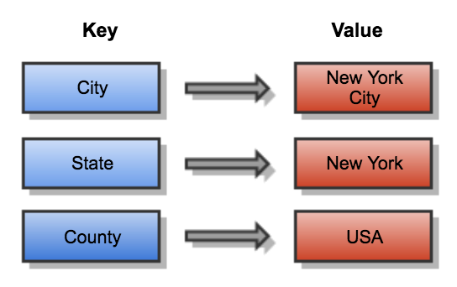
Types of NOSQL Databases
Key-value stores: stores data as a collection of key-value pairs in which a key serves as a unique identifier. This data structure more commonly known today as a dictionary.
It is the base of all other types and free schema.
Key-value databases store all key-value pairs together in a single namespace. It is not contain any type of grouping.

Slide 7
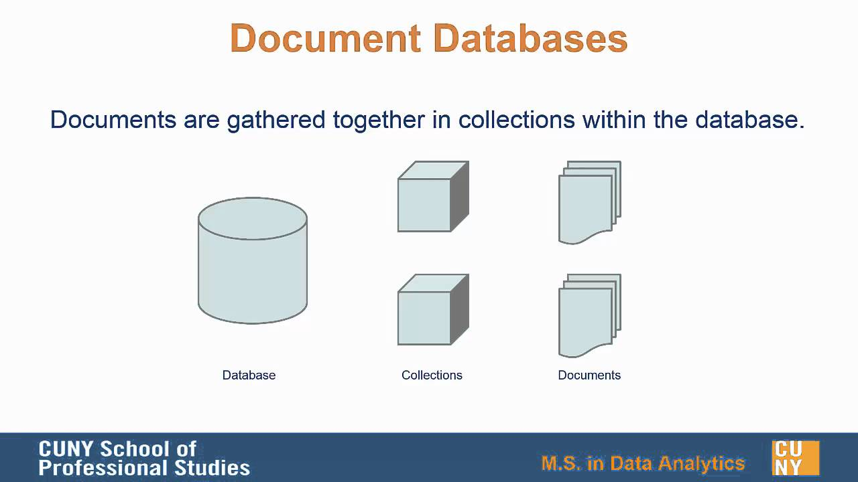
Types of NOSQL Databases
Document databases: Store data in documents written is most cases in JSON Format .
It is also free schema.
Document is treated like row in relational database and every group of documents is put in collection which is like table in relational database.

Slide 8
Types of NOSQL Databases
JSON stands for JavaScript Object Notation
Example of JSON Format
{"name":"John", "age":30, "car":null}
Wide-Column Stores: in this type we must know the groups of columns (category) but not columns itself, so we consider it semi-structure data.
It uses tables, rows, and columns, but unlike a relational database, the names and format of the columns can vary from row to row in the same table
Example: consider customer info. we know that there is a super column called address which is consider the main category of group of columns represent address, but we don not know if it contains ( street,city,country) or (street,stat,Zip Code) and so on.

Slide 9
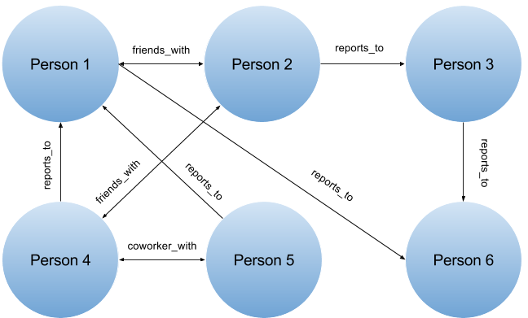
Types of NOSQL Databases
Graph databases : are purpose-built to store and navigate relationships. Relationships are first-class citizens in graph databases, and most of the value of graph databases is derived from these relationships. Graph databases use nodes to store data entities, and edges to store relationships between entities( Edge is essentially a line that connects one node to another).
Example

Slide 10
Document Database( like MongoDB)
Relational Database is based on normalization in structure design.
Normalization Advantage : avoid redundancy , minimize storage, consistency ( no duplicated data so there is not any choice to get different result if query same data from different storage table).
Normalization Disadvantage: Slow due to multiple join, maximize storage and lead to complex structure.
Document Database is based on denormalization in design.
Data for a topic is grouped together in the same document.
All related documents are grouped together in single collection and in some databases called container.

Slide 11
Document Database( like MongoDB)
Reading Single document should give you all info. About entity even if this required duplication.
This duplication can cause copies going out of synchronize but this is a trade off between consistency and speed in retrieve data.
Common Denormalized Techniques used to join data in document database:
Use Nested Fields : example inside order document insert nested JSON block for customer data.
{ “order”:””,”data”:””,”cust”:{“id”:””,”name”,””} }
Use Repeated Fields : example inside order document insert array for all items id in orders { “order”:””,”data”:””,”item ”:[ {“id”:””,”name”,””} , {“id”:””,”name”,””} ] }

Slide 12
Modeling Relationship in Document Database
Nested Documents:
It make sense to nested document inside another one which is consider denormalization instead of separate them and use only reference like RDB in the following cases:
Both Documents are usually read together.
Both Documents are usually write together.
Relation between two documents must be one-to-one or one-to-many

Slide 13
Modeling Relationship in Document Database
Reference Documents:
It make sense to reference to document inside another one, which is consider normalization technique like RDB instead of embedding in the following cases:
Both Documents are not read together.
Both Documents are not write together.
Relation between two documents is many-to-one or many-to-many
Example of many to many is projects and employees

Slide 14
Document Database ( General Notes)
Document database is consider schemeless by means there is no explicitly schema in separate docs (metadata for structure) but there is implicitly schema (every document has implicitly schema defined by the fields in docs.
When Document Database must be used?
If you're working with lots of unorganized data then a document database might suit you better, if your data is more structured and you application needs to access specific information and how it related to other data-points then a relational database is a better fit.

Slide 15
Graph Database
Definition: Graph database use graph structure to represent and store data.
Graph Definition: A group of nodes that are connected by directive relationships.
Graph Database Description: It is all about relation, Relationships are named and directive with start and end node.
Nodes and Relationships contain properties.
High Performance, Flexibility, support more than one query language(like cypher).

Slide 16
Graph Database
A schema in Graph database refers to indexes and constraints. Graph database is often described as schema optional, meaning that it is not necessary to create indexes and constraints. You can create data nodes, relationships and properties without defining a schema.
When define index this mean data can not be null so for this part only you will be tight to fixed schema

Slide 17
Graph Database
When Graph Database must be used?
With Highly connected data.
All Information I need is based basically on relation.
Document DB is good only if there is low join needed between entities.
RDB performance is very low with highly connected data in compare to graph db.
Use Cases of Graph DB:
Find friend of friend in social media.
For recommendation systems
Fraud detection

Slide 18
Graph Database (Like Neo4j)
Neo4j is written by java based on transaction, support big data and scalable and has Rest API so can communicate with any app.
Node can have label
Each Relation must be named and directive.
Each property is key value pair.
Key=String, Value=Primitive data types
Property can be indexed or add unique constraint.

